Slide 1

AROUND THE PICNIC TABLE
Finance
74th
General Service Conference
Kevin Prior, CFA, CPA
Class A (nonalcoholic) Trustee
General Service Board Treasurer

Slide 2

PART I: 2023 AUDIT RESULTS
2023
New Audit Firm for 2023 – Per 5-year RFP/Rotation Policy Adopted by Trustees Finance and Implemented by Trustees Audit, GSB, AAWS and AAGV boards
Introduce Matthew Becker, CPA, Lead Engagement Partner at BDO

Slide 3
2023 AUDIT RESULTS
Unmodified or “clean” audit opinion on the Consolidated Financial Statements
  The financial statements are fairly stated in all material respects.
All records and information requested were freely available for inspection.
BDO noted that they received full access to all information requested while performing the audit, and acknowledged the excellent cooperation extended by all levels of GSO and GV personnel throughout the course of the work.
Recognition of Value of Donated PSA airtime -- $33 million in 2022, $17 million in 2023. To be recognized annually going forward. Not recognizing the value was considered a significant deficiency.
1 control deficiency (100 contributions occurring in 2024 were recorded in 2023)
6 recommendations (1 HR, 3 GV, 1 Intercompany, 1 GSB) compared to 5 in 2022
Notes:
The recommendations are:
Ensure that documentation for all pay rate changes is maintained
GV consider using NetSuite instead of QuickBooks Online
GV estimate and update allowance for doubtful accounts regularly
The accounts of GV and LV should be separated and tracked on their own
Revise the intercompany agreement to specify what transactions are appropriate and provide guidance on allocation of expenses
Implement detailed procedures for the regular verification and reconciliation of the post-retirement medical fund liability.

Slide 4

Q&A For Auditors

Slide 5
PART II: GSB TREASURERS REPORT

Slide 6
2023 GSO FINANCIAL HIGHLIGHTS
7th Tradition of Self-Support – $10.84 million up 2.8% from $10.55 million in 2022
Operating Expense before Depreciation - $17.47 million up 9.9% from $15.90 million in 2022
  Program Service Expense - $9.00 million up 46.5% from $6.14 million in 2022
  Supporting Services Expense - $8.47 million down 13.1% from $9.76 million in 2022
Self-Support - covered 62% of operating expense
Cost of program services per individual – $6.43
AAWS publishing gross profits – $6.76 million up 38.2% from $4.89 million in 2022
Operating surplus before depreciation of $581,907; operating cash increase of $358,588
Notes:
Cost of services per individual based on 1.4 million individuals

Slide 7
GSO EXPENSES UNDER BUDGET IN 2023
Under Budget Categories represent 90% of total operating expense
EXPENSE | ACTUAL | BUDGET | DIFFERENCE
Payroll and Benefits | 10,349,012 | 10,561,688 | (212,676)
Professional Fees | 1,841,628 | 1,860,409 | (18,781)
Printing, Postage, Supplies, and Subs | 575,949 | 613,676 | (37,727)
Data, Automation, & Website | 573,591 | 642,844 | (69,253)
Insurance | 70,884 | 78,015 | (7,131)
Travel & Meetings | 2,147,709 | 2,170,916 | (23,207)
Total Operating Expense | 17,474,874 | 17,754,154 | (279,280)
Notes:
Subs is short for software subscriptions

Slide 8
GSO EXPENSES OVER BUDGET IN 2023
Over Budget Categories represent 10% of total operating expense
EXPENSE | ACTUAL | BUDGET | DIFFERENCE
Payroll Taxes | 692,343 | 659,745 | 32,598
Facility and Equipment | 1,223,760 | 1,166,861 | 56,899

Slide 9
INFLATION ADJUSTED GSO EXPENSE HISTORY
In 2023, operating expense was lower than inflation adjusted operating expense in 9 of the past 10 years.

Slide 10
2023 GRAPEVINE FINANCIAL HIGHLIGHTS
App launch – September 1, 2023
Grapevine paid print subscription income decreased 12% in 2023. Subscription income for the online, complete and mobile app magazine increased 72% due to the mobile app and increased Complete subscriptions.
2023 Grapevine results were a gross margin on subscriptions of $601,088 and a gross margin of $562,746 on other published items. Operating expenses of $2,059,058 resulted in an operating loss of $888,465 compared to a loss of $404,940 in 2022.
General Fund support of La Viña service activity was $753,376 in 2023, compared to $636,604 in 2022.
La Viña magazine circulation decreased by 3.0% in 2023 compared to a 4.3% increase in 2022.

Slide 11
2024 GSO BUDGET
Operating revenue $19,642,359 compared to $18,056,782 in 2023.
  Contributions $10,500,000 compared to $10,841,419 in 2023.
  Literature gross margin $8,492,759 compared to $6,763,226 in 2023.
Total operating expense $19,024,414 before $1.02M depreciation compared to $17,474,874 before $1.06M depreciation in 2023.
Operating surplus of $617,945 before depreciation compared to $581,907 surplus in 2023.

Slide 12
2024 GRAPEVINE BUDGET
Print magazine circulation expected to decrease to 46,969 from 49,296 in 2023.
Online and Complete circulation to increase to 4,625 from 3,002 in 2023.
10,069 new app subscribers compared to 3,400 in 2023.
Gross margin on subscriptions $1,147,021 compared to $601,088 in 2023.
Grapevine net deficit of $582,572 compared to a net deficit of $888,465 in 2023.
La Viña magazine circulation to increase to 6,782 compared to 6,484 in 2023.
General Fund La Viña support of $569,512 compared to $753,376 in 2023.

Slide 13


GRATITUDE – 7TH TRADITION

Slide 14
7TH TRADITION SELF-SUPPORT – 2015 – 2024

Slide 15
GROWTH OF ON-LINE CONTRIBUTIONS
2014 – 2023
A mail contribution costs $5.60 to process. An online contribution costs $2.93 to process, a $2.67 savings.
Notes:
Online contributions have grown from 5.2% of total contributions in 2014 to 25.9% in 2023.
In dollars, online contributions have grown from $343K in 2014 to over $2.8M in 2023.

Slide 16
CONTRIBUTIONS BY TYPE OF CONTRIBUTOR
2023
Notes:
Other orgs is mostly unlisted groups

Slide 17
CONTRIBUTIONS STATISTICS 2023
INDIVIDUALS
7th Tradition Self-Support Contributions | 3,540,104
Average Contribution | 129.88
Most Common Contribution | 50.00
Number of Contributions | 27,235
GROUPS
7th Tradition Self-Support Contributions | 5,950,279
Number of Active Groups | 57,222
Number of Groups Contributing | 18,105
Percentage of Groups Contributing | 31.64
Average Contributed by a Group During the Year | 328.65

Slide 18
Number of Group Contributions by Dollar Value 2023
/

Slide 19
Number of Individual Contributions by Dollar Value 2023
/

Slide 20

THROUGH OUR OWN SELF-SUPPORT

Slide 21


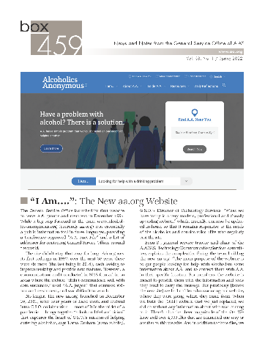
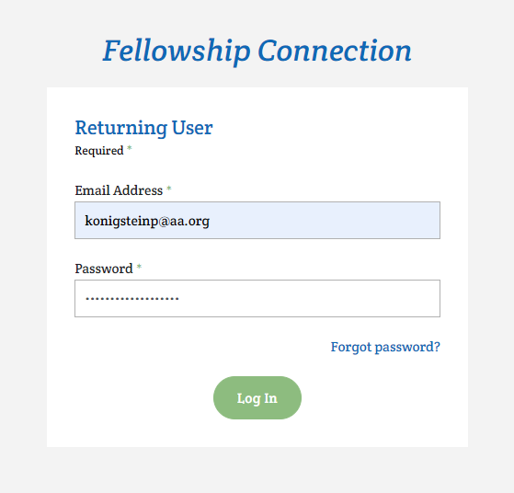
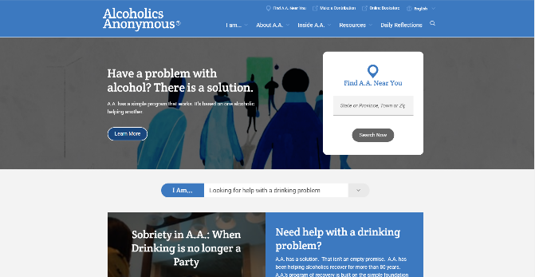
G.S.O.’s TWO BASIC FUNCTIONS
Publishing
Services on Behalf of the G.S.B.

Slide 22
AAWS – PUBLISHING – 2023 ACTUAL VS 2023 BUDGET
 | 2023 ACTUAL | 2023 BUDGET | INCREASE (DECREASE)
Gross Sales – Literature | 14,641,118 | 15,900,000 | (1,258,882)
Discounts | (453,706) | (715,500) | (261,794)
Shipping Charges | 302,805 | 397,500 | (94,695)
Net Sales - Literature | 14,490,217 | 15,582,000 | (1,091,783)
Cost of Literature Sold - Printing | 7,726,991 | 7,632,000 | 94,991
Gross Profit | 6,763,226 | 7,950,000 | (1,186,774)
Gross Profit Percentage | 46.2% | 50.0% | (3.8%)

Slide 23
CONSOLIDATED (GSO + GV) OPERATING EXPENSES – 2023
FINANCIAL STATEMENT EXPENSE CATEGORIES
PERCENTAGE BREAKDOWN
Notes:
All Other includes: Office Services 28,070 (GV); Insurance 73,419; Bad Debt 44,749 Misc. 420,040 (Misc. includes 253K GV and 49K LV), Selling (GV) 176,263, and credit card and bank fees 144,899
Facility and Equipment includes rent and 1,138,889 depreciation

Slide 24
2023 PRUDENT RESERVE
Beginning Balance January 1, 2023 | 12,924,561
Investment Earnings | 206,301
Drawdowns | (500,000)
Additions | 0
Ending Balance December 31, 2023 | 12,630,862
Composition of Ending Balance
Cash | 2,706,106
Certificates of Deposit (CDARs) | 10,449,356
Accrued Interest | 48,413
Less Grapevine subscription liability | (573,012)
Ending Balance | 12,630,862
Number of Months Expenses Held | Based on 2023 expenses | Based on 2024 expenses
January 1, 2023 | 7.35 | 6.98
December 31, 2023 | 7.18 | 6.82
Notes:
During 2023, the GV subscription liability was reduced from 1,243,500 to 573,012. In January 2024 it was reduced to 540,000.

Slide 25
USES OF GSB’s RESERVE FUND
Concept of GSB’s Prudent Reserve – not same as in your Home Group’s reserve
GSB’s Reserve Fund covers much more
In 1967, the General Service Conference issued the Advisory Action that “The GSB make use of investment income from the Reserve Fund for whatever purpose the Board may authorize”.
Broadly, this could include, whether planned or unplanned:
  Operating Deficits of AAWS or Grapevine
  Periodic expenditures such as an office renovation or major technical upgrade
  Extraordinary expenses outside of “normal” operations

Slide 26
RESERVE FUND POLICY
1977 Advisory Action established the upper limit of the reserve fund as 12 months of operating expense of GSB, AAWS, and GV combined
A 1981 Advisory Action specified that a lower limit not be provided. However, a 9 month lower limit appears in Conference Finance Committee reports throughout the history of the reserve.
Policy adopted by GSB in 2022 includes:
  a 9 to 12 month goal range
  At least 50% of the portfolio available within one year
  GSB must authorize transfers into and withdrawals from the Reserve Fund
  In the event of emergencies such as a bank failure or inability to meet payroll, Trustees Finance and Budgetary Committee may authorize a withdrawal. If the Committee is unable to be gathered within the needed timeframe, two officers of the GSB may authorize.

Slide 27
GSO REVENUE TREND

Slide 28

THANK YOU
Paul Konigstein, Chief Financial Officer
Zenaida Medina, Controller
Donna Chahalis, Grapevine Controller
Diana L, Conference Coordinator, for her patience
All of the employees of both A.A.W.S. and Grapevine
Members of Trustees’ Finance and Budgetary Committee, along with members of the Finance Committees of A.A.W.S. and Grapevine and the Conference Finance Committee
Our Independent Auditors – BDO USA
Our outsourced accounting support – Your Part-time Controller
Any questions – Please feel free to contact me at – kevin@kevinjprior.com

